Slide 1


Startup Idea Validator
Group : G566
Team Members:
23bd1a0502
23bd1a050Z
23bd1a0546
23bd1a0547
23bd1a054X

Slide 2
Problem Statement
Many founders have startup ideas but are unsure if those ideas are viable.​
They lack structured evaluation and rely on random opinions.​
No easy tool to judge feasibility, market potential, uniqueness, or revenue scope.​
Difficulty in accessing mentors or experts for feedback.​
Need for a simple AI-based platform that evaluates ideas and provides actionable feedback.

Slide 3
Abstract / Overview
Startup Idea Validator is an AI-based web platform designed to validate and evaluate startup ideas objectively.
It assists early-stage founders by providing AI-driven feedback, feasibility analysis, and expert mentorship.
The project integrates machine learning models to deliver structured and data-backed insights.

Slide 4
Existing Vs Proposed System
Existing System:
Startup evaluation is mostly manual and subjective.
Entrepreneurs depend on mentors or incubators for idea feedback.
Feedback is inconsistent and lacks data-driven analysis.
Proposed System:
Provides an AI-powered web platform for automated idea validation.
Uses Llama 3 / OpenAI API to generate viability scores and feedback
Enables expert mentoring, semantic idea search, and secure cloud storage.
Supports user authentication, history tracking, and idea updates

Slide 5
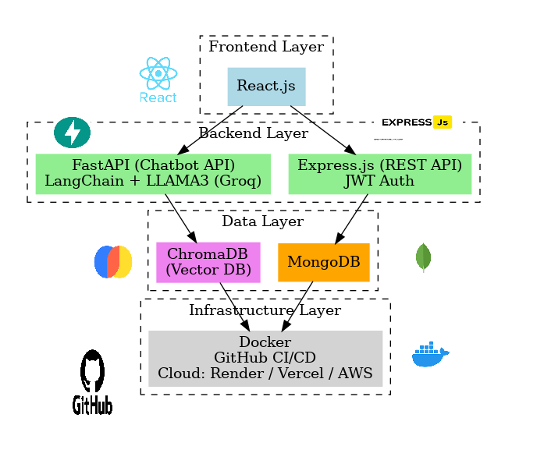






Technology Stack / Tools
Frontend: ReactJS for interactive UI.
Backend: Node.js + FastAPI for logic and AI orchestration.
Database: MongoDB + Pinecone for storage and semantic search.
AI: OpenAI for intelligent validation feedback.
Deployment: Docker, Render/AWS for scalable hosting.
Pinecone DB
(vector DB)

Slide 6
User Flow
User Registration and authentication
Suggestions and Idea
Check History
Idea Creation and Ai Validation
Connect with Expert

Slide 7
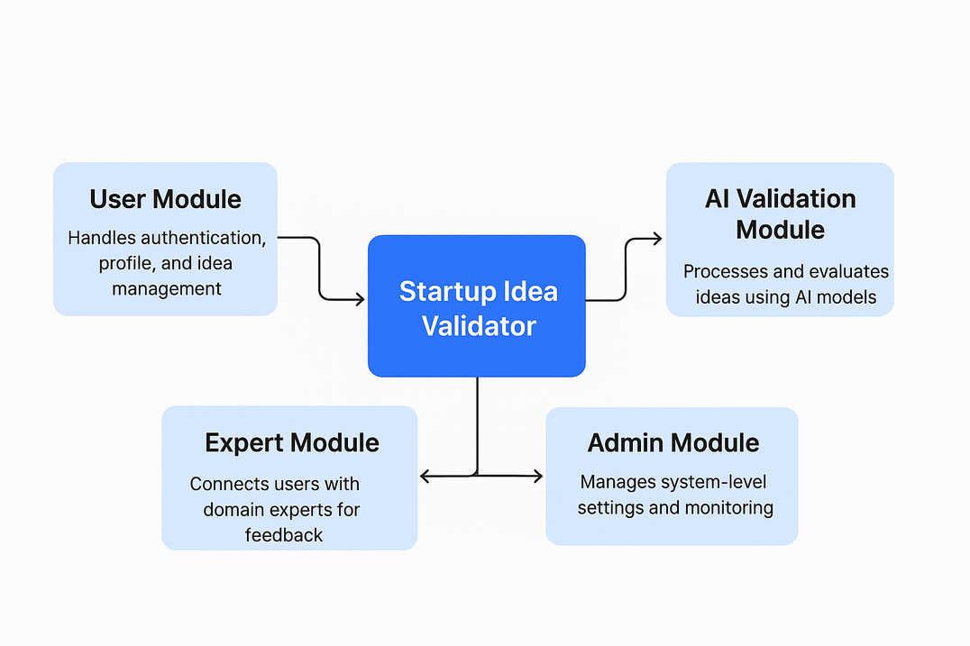
Modules
User Module – Handles authentication, profile, and idea management.
AI Validation Module – Processes and evaluates ideas using AI models.
Expert Module – Connects users with domain experts for feedback.
Admin Module – Manages system-level settings and monitoring.

Slide 8
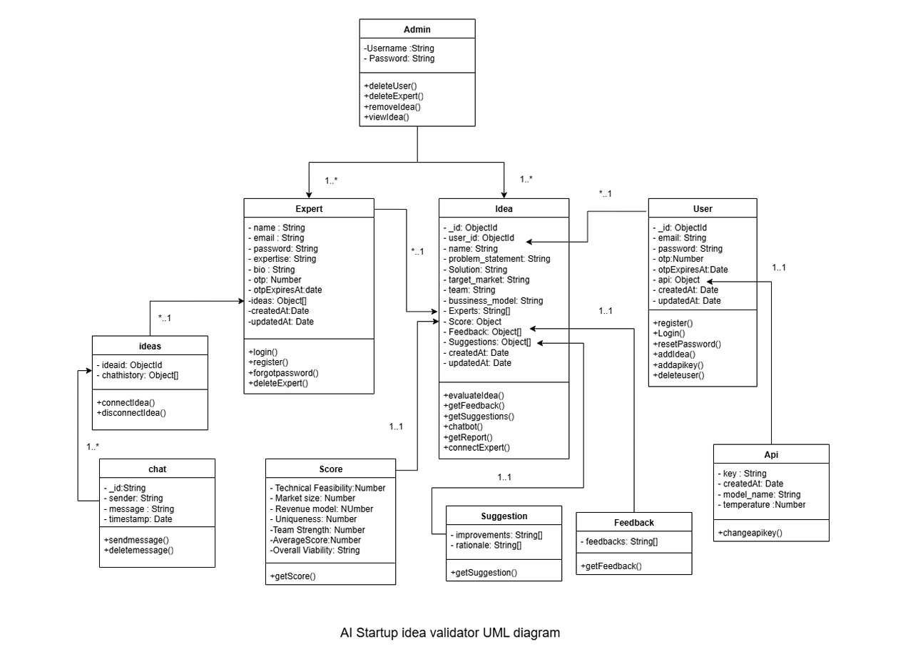

Slide 9

Features
Rapid AI-based idea evaluation​
Personalized suggestions​
Helps early-stage founders save time​
Easy platform for students and innovators
Can provide exposure for real time working of idea by interacting with experts

Slide 10
Objectives
Automate startup idea validation using AI.
Provide personalized feasibility and market analysis feedback.
Enable idea mentorship through expert connections.
Simplify startup evaluation for students and innovators.
Offer an interactive and secure full-stack web platform.

Slide 11
Future Scope
Integrate mobile app version for wider accessibility.
Enhance AI models for predictive success metrics.
Add investor matchmaking and funding support features.
Introduce analytics dashboards for user and system insights.

Slide 12
Conclusion
Startup Idea Validator bridges the gap between ideation and execution.
It provides an AI-powered, structured evaluation framework.
The platform empowers innovators to refine their startup ideas effectively.

Slide 13
Thank You
Questions are welcome.
Web Application : LINK
DEMO Video : LINK

